Slide 1
NEURAL NETWORK TECHNIQUE FOR DETECTING FACIAL EXPRESSIONS OF EMOTIONS
Submitted in the partial fulfillment for the award of the degree of
BACHELOR OF ENGINEERING
IN
AITCSE-AIML
Submitted by:
Akshay Kumar Kushwaha
20BCS6815
Under the Supervision of:
SHUBHANGI MISHRA
Department of AIT-CSE
DISCOVER . LEARN . EMPOWER

Slide 2
Outline
Introduction to Project
Problem Formulation
Objectives of the work
Methodology used
Results and Outputs
Conclusion
Future Scope
References

Slide 3
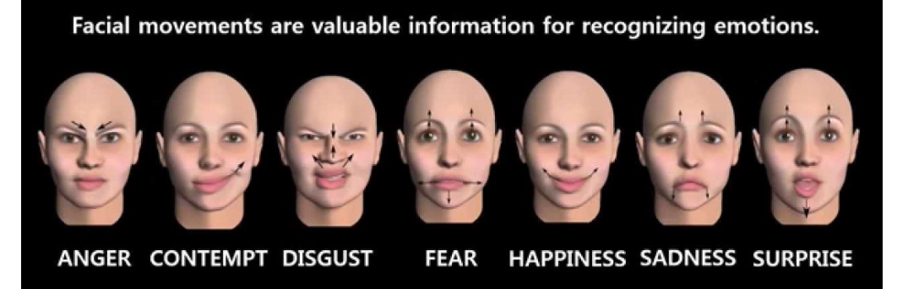
Introduction to Project
Human face is full of emotions in various situations and complex to understand. There are some common and basic emotions like happy, sad, anger, neutral, fear, confused and disgust.
With the help of huge raw data of various emotions and its patterns in image format, computer vision is reachable to detect the human emotions.

Slide 4
Problem Formulation
Emotions are the key to understanding human interactions, especially those conveyed with facial expressions. Without these emotions no one can determine the mental state of a person and those are also being faked sometimes perfectly.
It is too hard for computer vision to classify them into correct labels. Every data must be taken into consideration for getting as precise results as we can. Many emotions are taken into the data for creating larger model for detecting those. It is possible to apply emotion recognition to pictures, video, audio.

Slide 5
Objectives of the Project
Here in this project many problems are hence it has various objectives that are as follows:
The main objective of emotion recognition or detection using neural networks is identifying emotions of a human.
2) Differentiating all kinds of emotions especially complex and similar emotions such as sad, neutral, confused and disgust.
3) Optimizing huge dataset named “FER2013”, which has a raw data of various emotions in image format.
4) Calculating and analyzing the accuracy of the model.
5) Representing the outcomes in a graphical format.

Slide 6
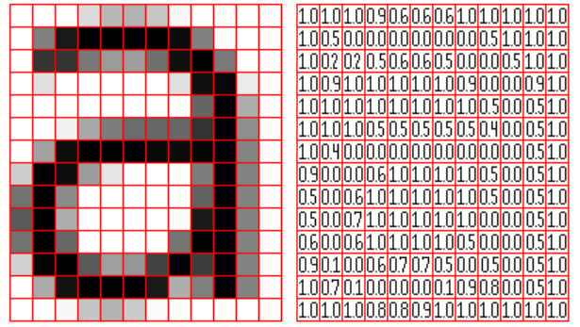
Methodology used
Methodology used in this project is Convolutional Neural Networks, which is a special technique in Neural networks widely used for computer vision.
An image is divided into many pixels and constructed in a matrix form. After this it is loaded into arrays for functioning.

Slide 7
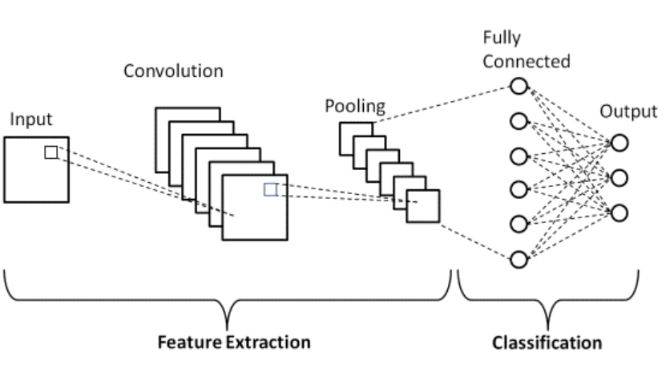
There are two main parts to a CNN architecture
A convolution tool that separates and identifies the various features of the image for analysis in a process called as Feature Extraction.
The network of feature extraction consists of many pairs of convolutional or pooling layers.
A fully connected layer that utilizes the output from the convolution process and predicts the class of the image based on the features extracted in previous stages.

Slide 8
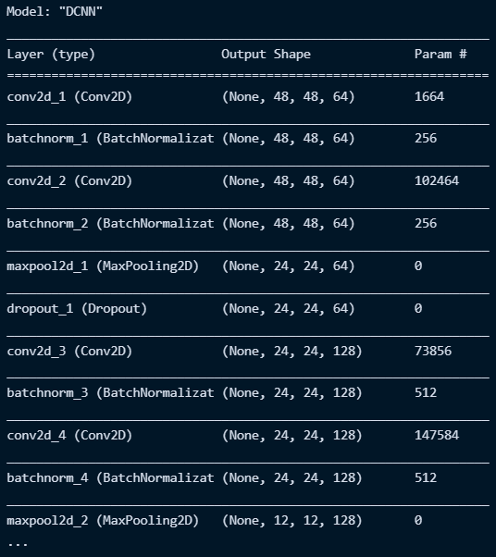
Results and Outputs
Epoch 69/100 596/598 [============================>.] - ETA: 0s - loss: 0.3943 –
accuracy: 0.8429Restoring model weights from the end of the best epoch. 599/598 [==============================] - 12s 21ms/step - loss: 0.3942 –
accuracy: 0.8428 - val_loss: 0.4596 - val_accuracy: 0.8256
Epoch 00069: early stopping

Slide 9
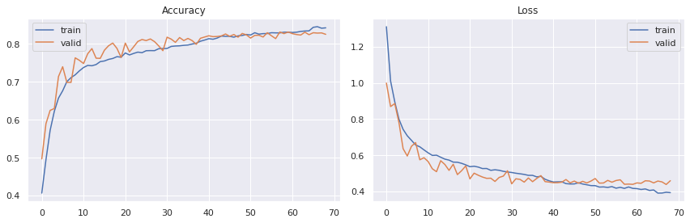
Accuracy –
Accuracy score is the number of correct predictions obtained.
Accuracy is one metric for evaluating classification models. Accuracy is the fraction of predictions our model got right. Accuracy = Number of correct predictions / Total number of predictions.

Slide 10
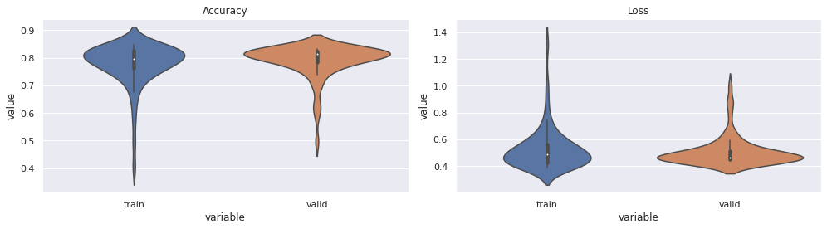
Loss –
Loss values are the values indicating the difference from the desired target state.

Slide 11
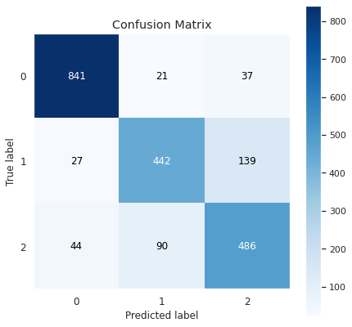
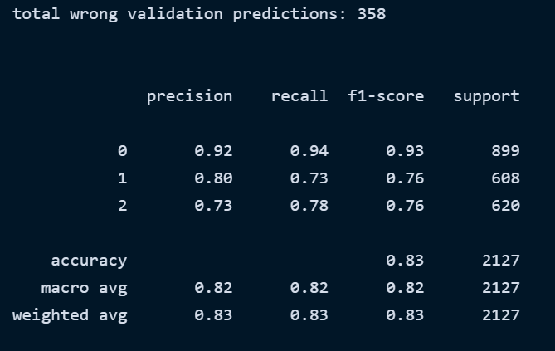
Confusion matrix shows the true evaluation of model in the form of matrix. For the classifier, it is better way to evaluate the performance.

Slide 12
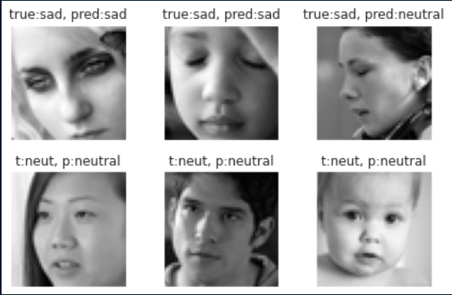
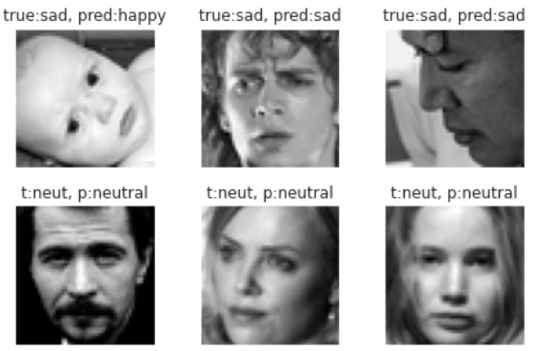
This is the prediction result from the tested on the test dataset. Only in two images, which is not quite clear there predictions are not correct. So, we are going to test these model on real time images.

Slide 13
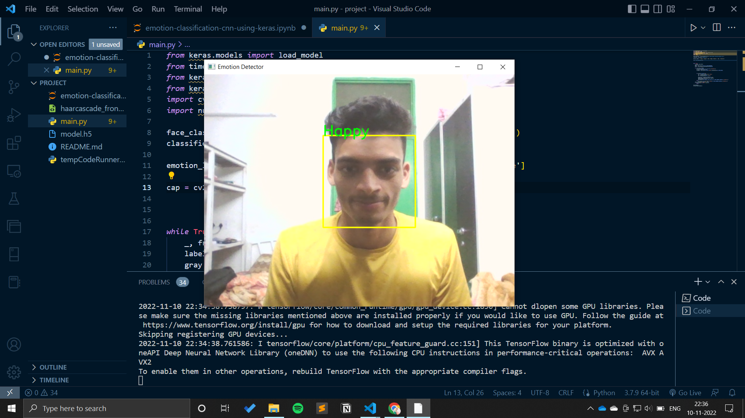

Testing on real time images

Slide 14
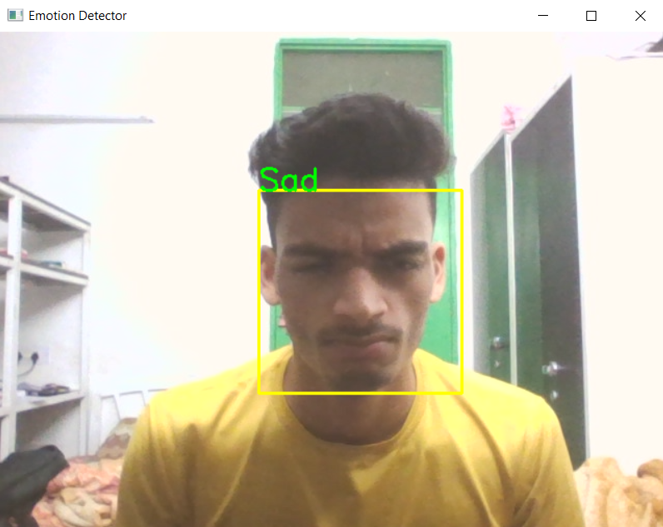
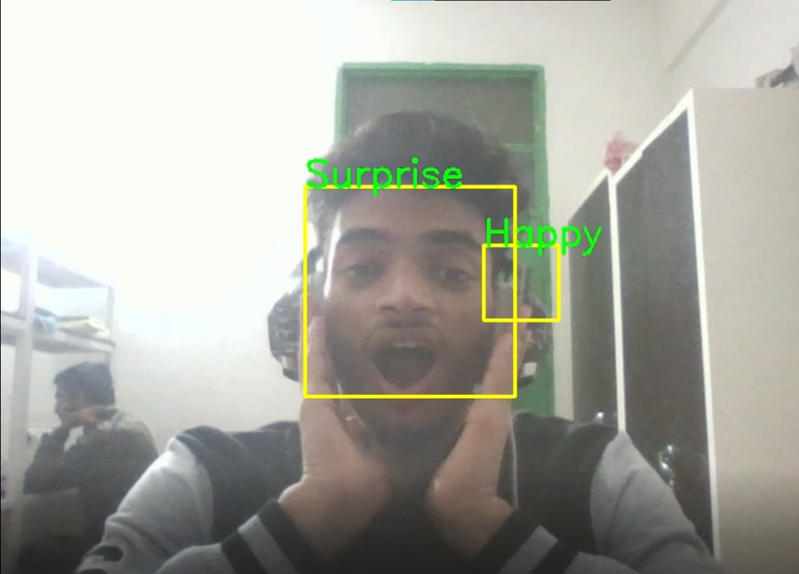
These pictures are for testing of sed and surprise correctly.
80%

Slide 15

This is a Flutter Application. Implemented an UI based application using flutter. Used .tflite model type file to run in this application. This is functionally working and predicting the result correctly.

Slide 16
Conclusion
In this project emotions of a human face are being detected efficiently and analyzed the patterns of various kinds of expressions of emotions. Research suggests that the facial expressions accompanying anger, disgust, fear, happiness, sadness, and surprise are human universals, and the amygdala is central to emotion recognition.
Accuracy of our model is 84.659 which is more then others worked on this project. Because data is too large and CNN is not able to perform better on less time. We have used DCNN which helped us to calculate it in very less time and made it accurate for our model.
Working with grey pictures for training made us to lead over other model. This model is performing in real time with the correct predictions.

Slide 17
Future Scope
Technologies based on facial expression recognition (FER, also known as affect recognition) form a significant part of the emotion recognition market, estimated to reach a value of $56 billion by 2024.
Emotion recognition provides benefits to many institutions and aspects of life. It is useful and important for security and healthcare purposes.
Also, it is crucial for easy and simple detection of human feelings at a specific moment without asking them.

Slide 18
References
https://www.researchgate.net/publication/344331972_Facial_Emotion_Detection_Using_Neural_Network/link/5f68e384a6fdcc0086340933/download
file:///C:/Users/vicky/Downloads/Facial-Emotion-Detection-Using-Neural-Network.pdf
https://www.ripublication.com/ijaer18/ijaerv13n8_119.pdf
https://peltarion.com/knowledge-center/modeling-view/build-an-ai-model/blocks/2d-convolution
https://www.upgrad.com/blog/basic-cnn-architecture/
https://www.researchgate.net/figure/Visualization-of-a-fully-connected-layer-Taken-from-Hollemans-72_fig4_336607800

